Slide 1
Computer Representation of Venn and Euler Diagrams
Diunuge B. Wijesinghe, Surangika Ranathunga, Gihan Dias
Department of Computer Science and Engineering, University of Moratuwa, Sri Lanka
{diunuge.10, surangika, gihan}@cse.mrt.ac.lk

Slide 2
Introduction
Diagrams are a very important communication medium
Mathematical diagram understanding is a complex challenge
Diagram understanding is an important pre-requisite of various fields such as image database systems, and educational diagram grading systems
There is no significant research done to interpret Venn and Euler diagrams
We address the problem of computer understanding of Venn and Euler diagrams that are available in vector format

Slide 3
Motivation
Venn & Euler diagrams are a significant part of Mathematics
Especially in secondary-level exams such as London O/L and SAT Mathematics
For the automatic assessment of diagrams, diagram interpretation is the important first step
For Venn & Euler diagrams, such an interpretation method is not available

Slide 4
Previous Work
Futrelle et al [1] presented a diagram understanding system to interpret diagrams based on constraint grammars. The system is capable of handling x-y graphs and gene diagrams in Biological domain [2].
Huang et al [3, 4] developed a system that can understand chart images.
Burton et al [5] introduced an abstract syntax for Euler diagram representation
Thomas et al [6, 7, and 8] developed a computer aided assessment system that can handle graph based diagrams such as Entity-Relationship diagrams and flow charts

Slide 5
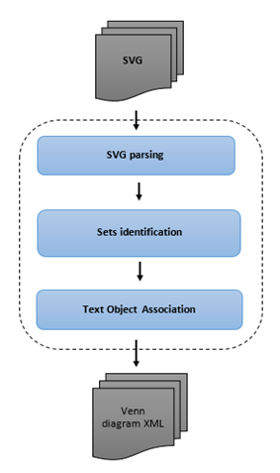
Venn & Euler Diagram Parser
Venn & Euler diagrams with Jordan curves are handled.
Sets are represented with Rectangles, Circles & Ellipses
Each set is represented with only one curve
System accepts SVG vector images as the input diagram
Some diagrammatic systems use their own image structures
SVG diagram is parsed & domain related information is extracted
Interpreted diagram is given as XML output

Slide 6
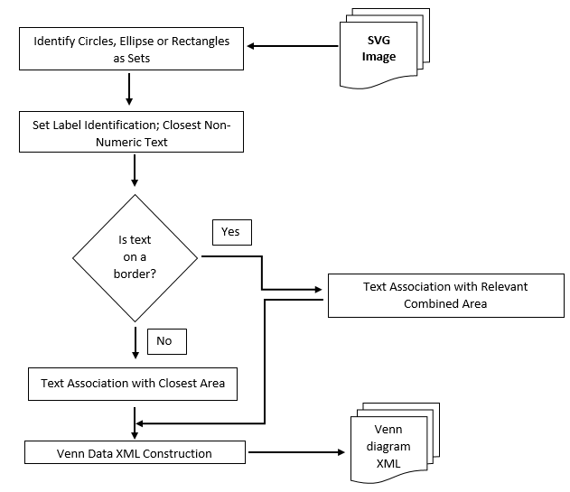
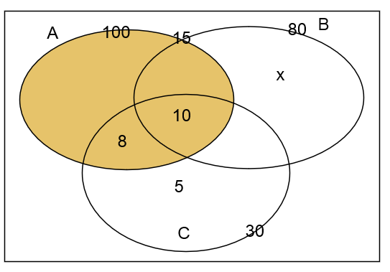
Venn & Euler Diagram Parser – Text Association
Text association is the most difficult part of the research
Have to deal with text ambiguities
Have to deal with human mistakes
Close distance parameters are tuned with reference to minimal font size of an image
Text-area association depends on the centroid, size of the area and the text location

Slide 7
Diagram Representation: Mathematical Model
Abstract Syntax (Extended the syntax introduced by Burton et al [5])
Labels = {A, B, C}
Curves = {c_{a}, c_{b}, c_{c}}
Regions(Called Zones) = {{~c_{a}.~c_{b}.~c_{c}}, {~c_{a}.~c_{b}.c_{c}}, {~c_{a}.c_{b}.~c_{c}}, {~c_{a}.c_{b}.c_{c}}, {c_{a}.~c_{b}.~c_{c}}, {c_{a}.~c_{b}.c_{c}}, {c_{a}.c_{b}.~c_{c}}, {c_{a}.c_{b}.c_{c}}}
No of elements = {{c_{a}=100}, {c_{b}=80}, {c_{c}=30}, {c_{a}.c_{b}=15}, {~c_{a}.~c_{b}.c_{c} =5}, {~c_{a}.c_{b}.~c_{c}=x}, {c_{a}.~c_{b}.c_{c}=8}, {c_{a}.c_{b}.c_{c}=10}}
Shaded Zones ={c_{a}}
Venn Diagram in SVG file format

Slide 8
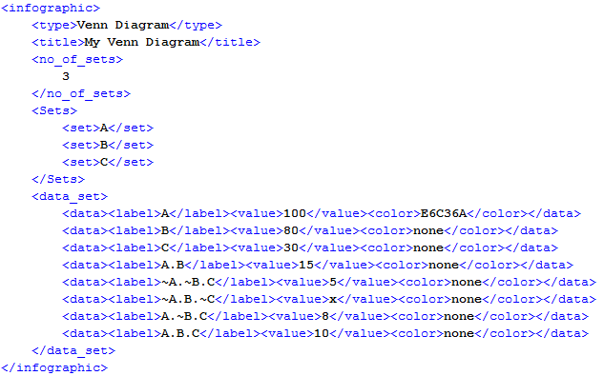
Diagram Representation Contd.
Venn Diagram in SVG file format
Venn Diagram after parsing

Slide 9
Evaluation
Venn parser is tested and tuned using the Venn diagrams gathered from university undergraduates, which are drawn directly using an SVG editor
For the evaluation, collected hand-written answer scripts (includes GCE O/L questions) that collectively contained 3 Venn and 4 Euler diagrams from university undergraduates and grade 10 school students
Collected 77 diagrams are converted to SVG using a editor & given to the parser
Parser results are validated for each diagram manually

Slide 10
Results
Diagram No. | Diagram Type | Correctly Parsed | Incorrectly Parsed | Accuracy
1 | Venn | 17 | 2 | 89.5%
2 | Venn | 12 | 0 | 100%
3 | Euler | 11 | 0 | 100%
4 | Euler | 11 | 0 | 100%
5 | Euler | 3 | 2 | 60.0%
6 | Euler | 5 | 3 | 62.5%
7 | Venn | 10 | 1 | 90%

Slide 11
Results
Diagram 1 and 2 contain two sets and remaining diagrams contains 3 sets.
Drawings for diagram 1 were collected from school student answer scripts and remainder were collected from university undergraduates.
Diagram 5 and 6 had fewer answers because of the higher complexity of the question.
All of the parsing errors are due to the ambiguity of text labels and some text labels being too far away from the arrows that are supposed to be arrow labels.
System showed an accuracy of 89.61%.

Slide 12
Future Work
Currently sets drawn using rectangles, circles, and ellipses are supported. This method can be extended to apply for sets drawn with any type of Jordan curves.
In some Venn and Euler representations, one set label can have more than one Jordan curve. This method can be extended to address those representations.
Machine learning approaches can be used to improve the label classification and clustering.
Need annotated data

Slide 13
Discussion
Diagram understanding is a complex problem in the computer research field.
Structured diagrams can be dealt with using domain ontology.
Unstructured drawing understanding is a very complex problem.
In particular, dealing with human drawn diagrams is difficult due to the ambiguity problems and human errors.

Slide 14
Acknowledgement
This research is funded by the 2015 University of Moratuwa Senate Research Grant (SRC), and DL4D 2016 research grant.

Slide 15
References
R. P. Futrelle, I. Kakadiaris, J. Alexander, C. M. Carriero, N. Nikolakis, and J. M. Futrelle, “Understanding diagrams in technical documents,” in IEEE Computer, 1992, Vol. 25(7), pp. 75-78.
R. P. Futrelle and N. Nikolakis, “Efficient analysis of complex diagrams using constraint-based parsing. In Document Analysis and Recognition,” in Proceedings of the Third International Conference on IEEE, 1995, Vol. 2, pp. 782-790.
W. Huang, C. Tan, and W. K. Leow, “Associating text and graphics for scientific chart understanding. In Document Analysis and Recognition,” in Proceedings of the Eighth International Conference on IEEE, 2005, pp. 580-584.
W. Huang, C. Tan, “A System for Understanding Imaged Infographics and Its Applications,” in Proceedings of the 2007 ACM symposium on Document engineering - DocEng '07, 2007.

Slide 16
References
J. Burton, G.Stapleton, J. Howse, and P. Chapman, "Visualizing concepts with Euler diagrams," in International Conference on Theory and Application of Diagrams, Springer Berlin Heidelberg, 2014.
N. Smith, P. Thomas, and K. Waugh, "Interpreting imprecise diagrams," Diagrammatic Representation and Inference. Springer Berlin Heidelberg, 2004. 239-241.
P.Thomas, K. Waugh, and N. Smith, "Experiments in the automatic marking of ER-diagrams," ACM SIGCSE Bulletin, Vol 37(3), pp. 158-162, 2005.
P. Thomas, K. Waugh, and N. Smith, "Using patterns in the automatic marking of ER-diagrams," ACM SIGCSE Bulletin. Vol. 38(3), 2006.

Slide 17
Thank You..!

